Slide 1
Introducing Reinforcement learning
Scott O’Hara
Metrowest Developers Machine Learning Group
01/29/2020

Slide 2
References
The material for this talk is primarily drawn from the Matiisen article and the slides, notes and lectures of the courses below:
“Demystifying Deep Reinforcement Learning,” 2015, Tambet Matiisen
I follow approach up through (non-deep) Q-Learning.
https://www.intel.ai/demystifying-deep-reinforcement-learning/
University of California, Berkeley CS188:
CS188 – Introduction to Artificial Intelligence, Profs. Dan Klein, Pieter Abbeel, et al. http://ai.berkeley.edu/home.html
David Silver, DeepMind:
Introduction to Reinforcement Learning http://www0.cs.ucl.ac.uk/staff/d.silver/web/Teaching.html
CS181 course at Harvard University:
Material used from multiple offerings of the course. Detailed links and references at end of the slide deck.

Slide 3
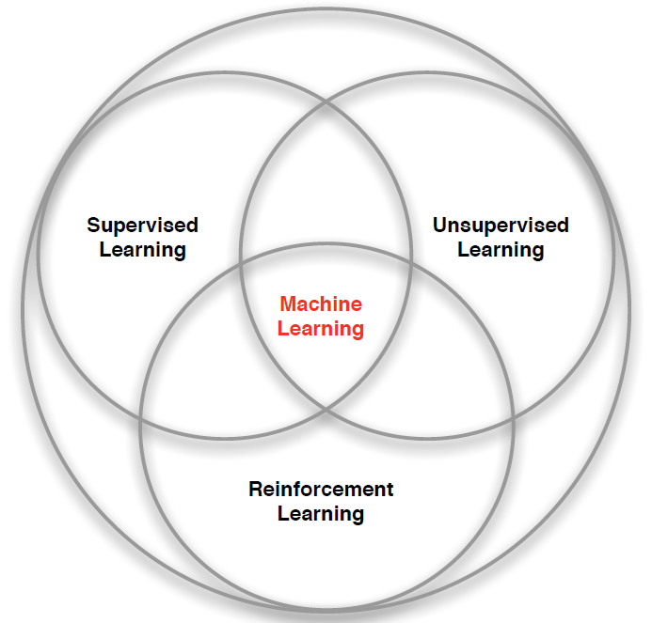
3 Types of Machine Learning
Supervised Learning – Learn a function from labeled data that maps input attributes to an output label e.g., linear regression, decision trees, SVMs.
Unsupervised Learning – Learn patterns in unlabeled data e.g., principle component analysis or clustering algorithms such as K-means, HAC, or Gaussian mixture models.
Reinforcement Learning – An agent learns to maximize rewards while acting in an uncertain environment.
Credit: image borrowed from lecture slides David Silver, DeepMind, “Introduction to Reinforcement Learning

Slide 4
Some Characteristics of Reinforcement Learning
Learning happens as the agent interact with the world.
There are no training or test sets. Training is guided by rewards and punishments obtained by acting in an environment.
The amount of data an agent receives is not fixed. More information is acquired as you go.
Actions are not always rewarded or punished immediately. “Delayed gratification” is possible.
Agent actions can affect the subsequent data it receives. E.g., closing a door that can’t be opened again.

Slide 5
Reinforcement Learning Example: Playing Atari breakout
Google DeepMind's Deep Q-Learning & Superhuman Atari Gameplays
https://youtu.be/Ih8EfvOzBOY
3 mins 45 secs
Credit: Two Minute Papers - Károly Zsolnai-Fehér
Notes:
Convert to a video.

Slide 6
Reinforcement Learning Example: Terrain traversal
Terrain Traversal with Reinforcement Learning
https://youtu.be/_yjHPu1aYCY
2 mins 38 secs
Credit: Two Minute Papers #26- Károly Zsolnai-Fehér
Notes:
Convert to a video.

Slide 7
Reinforcement Learning Examples:
Fly stunt maneuvers in a helicopter
Defeat the world champion at Backgammon
Manage an investment portfolio
Control a power station
Make a humanoid robot walk
Play Atari games better than humans
https://youtu.be/2pWv7GOvuf0?t=940
(15:40 – 22.00 [6 mins 20 secs)
Credit: David Silver, DeepMind, “Introduction to Reinforcement Learning
Notes:
Review this list and make it consistent with the video.

Slide 8
MARKOV DECISION PROCESSES
The Markov Decision Process (MDP) provides a mathematical framework for reinforcement learning.
An MDP is used to model optimal decision-making in situations where outcomes are uncertain.
<https://en.wikipedia.org/w/index.php?title=Markov_decision_process&oldid=855934986> [accessed 11 September 2018]

Slide 9
The MDP decision framework
Markov decision processes model uncertainty
Use probability to model uncertainty about the domain.
Markov decision processes model an agent’s objectives
Use utility to model an agent’s objectives. The higher the utility, the “happier” your agent is.
Markov decision processes find an optimal decision policy
The goal is to discover an optimal decision policy π specifying how the agent should act in all possible states in order to maximize its expected utility.

Slide 10
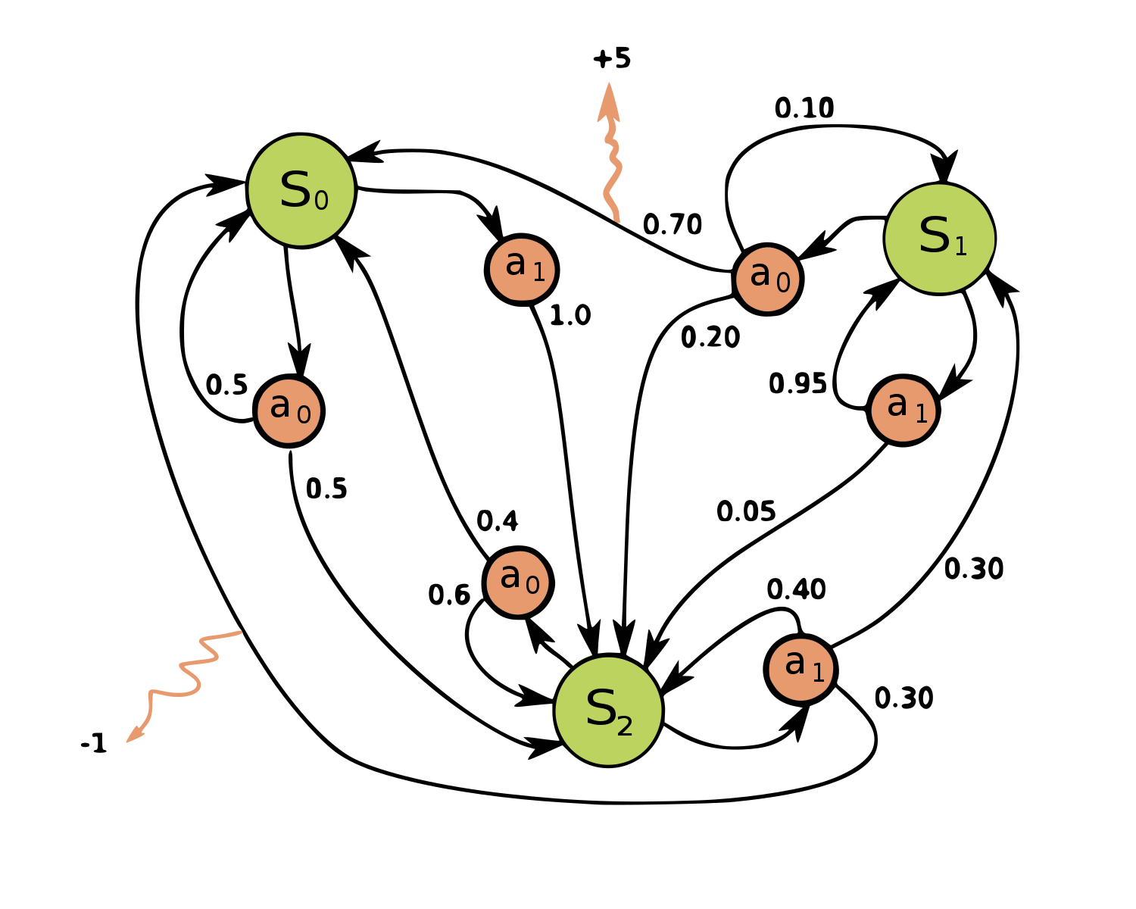
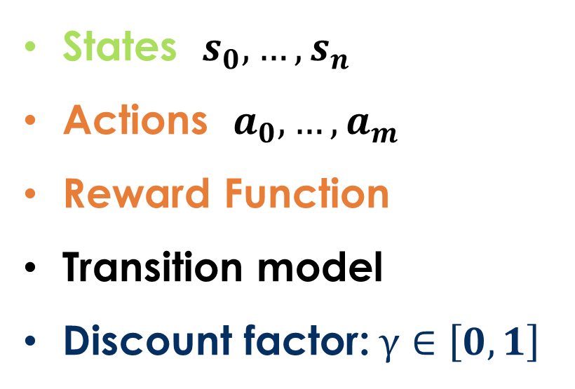
Markov decision processes
States: $s_{0},…,s_{n}$
Actions: $a_{0},…,a_{m}$
Reward Function:
Transition model:
Discount factor:$γ∈\left[0,1\right]$
<https://en.wikipedia.org/w/index.php?title=Markov_decision_process&oldid=855934986> [accessed 11 September 2018]

Slide 11
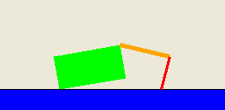
Application: Crawler robot
Arm1
Location
Arm2
States: <Location, Arm1 angle, Arm2 angle>
Actions: increase Arm1 angle, decrease Arm1 angle,
increase Arm2 angle, decrease Arm2 angle.
Reward Function: +1 if robot moves right, -1 if robot moves left.
Transition model: model of box movement caused by arm movements.

Slide 12
Algorithms Based on the Markov Decision Process
There are many algorithms based on the Markov Decision Process
These algorithms can be divided into several subclasses. One way to classify these algorithms is based on how much is known about the environment.
MDP algorithms
MDP-based algorithms assuming perfect knowledge of the states, actions, rewards and transitions of the problem space.
Reinforcement learning algorithms:
MDP-based algorithms with knowledge of the states and actions but no knowledge of the rewards and transitions of the problem space.

Slide 13
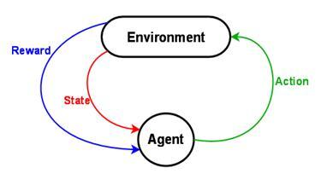
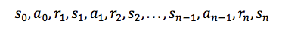
The Reinforcement Learning Problem
<https://www.intel.ai/demystifying-deep-reinforcement-learning> [accessed 29 January 2020]

Slide 14
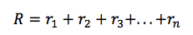
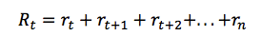
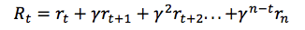
Discounted Reward
Total Future Reward:
Total Reward for One Episode:
Total Discounted Future Reward (γ is the discount factor between 0 and 1)
<https://www.intel.ai/demystifying-deep-reinforcement-learning> [accessed 29 January 2020]

Slide 15
Discounted Reward
If we set the discount factor γ=0, then our strategy will be short-sighted and relies only on immediate rewards.
If we want to balance between immediate and future rewards, we should set discount factor to something like γ=0.9.
If the reinforcement learning problem is episodic i.e., each learning trial finishes after a finite time then we can set the discount factor γ=1 since the total reward will be finite. For continuous RL problems, the discount factor must be less than 1 otherwise, the total reward would be infinite.
A typical strategy for an agent balances (1) exploiting the environment by choosing an action that maximizes the (discounted) future reward; and (2) exploring the environment by choosing some other action.
<https://www.intel.ai/demystifying-deep-reinforcement-learning> [accessed 29 January 2020]

Slide 16
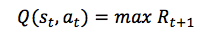
Q-Learning
In Q-learning we define a function Q(s, a) representing the maximum discounted future reward when we perform action a in state s and continue optimally from that point on.
The way to think about Q(s, a) is that it is “the best possible score [one is likely to get] at the end of an [episode] after performing action a in state s“.
It is called Q-function, because it represents the “quality” of a certain action in a given state.
<https://www.intel.ai/demystifying-deep-reinforcement-learning> [accessed 29 January 2020]

Slide 17
Editing^

Slide 18
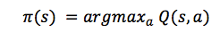
Q(s,a) gives the Optimal Policy
Suppose you are in state s and pondering whether you should take action a or b. You want to select the action that results in the highest score at the end of game.
Once you have the magical Q-function, the answer becomes simple – pick the action with the highest Q-value!
Here π represents the policy, the rule how we choose an action in each state.
<https://www.intel.ai/demystifying-deep-reinforcement-learning> [accessed 29 January 2020]

Slide 19
The bellman Equation
The Bellman equations are at the heart of all MDP-based algorithms. It can be show that when the Bellman equations are satisfied, an optimal policy π has been found.
The main idea in Q-learning is that we can iteratively approximate the Q-function using the Bellman equation.
With the Bellman Equation, we express the Q-value of state s and action a in terms of the Q-value of the next state s’.
The maximum future reward for state s and action a is the immediate reward plus maximum future reward for the next state s’.
<https://www.intel.ai/demystifying-deep-reinforcement-learning> [accessed 29 January 2020]

Slide 20
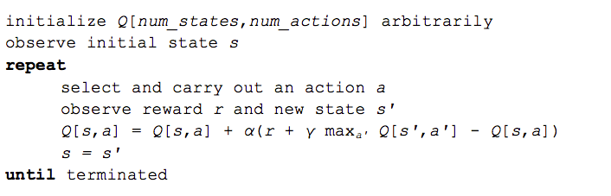
The Q-Learning Algorithm
α in the algorithm is a learning rate that controls how much of the difference between previous Q-value and newly proposed Q-value is taken into account.
<https://www.intel.ai/demystifying-deep-reinforcement-learning> [accessed 29 January 2020]

Slide 21
Rewriting The Q(s,a) update
$$Q\left[s,a\right]←Q\left[s,a\right]+α(r+γ\max_{a^{′}}{Q_{k}\left[s^{′},a^{′}\right]}−Q\left[s,a\right])$$
Can be rewritten as:
$$Q\left[s,a\right]←\left(1−α\right)Q\left[s,a\right]+α(r+\underset{a^{′}}{γmax}{Q_{k}\left[s^{′},a^{′}\right]})$$
<https://www.intel.ai/demystifying-deep-reinforcement-learning> [accessed 29 January 2020]

Slide 22
The Q-Learning Algorithm Converges on the True q-value
The max_{a’} Q[s’,a’] that we use to update Q[s,a] is only an approximation and in early stages of learning it may be completely wrong.
However the approximation get more and more accurate with every iteration and it has been shown, that if we perform this update enough times, then the Q-function will converge and represent the true Q-value.
<https://www.intel.ai/demystifying-deep-reinforcement-learning> [accessed 29 January 2020]

Slide 23
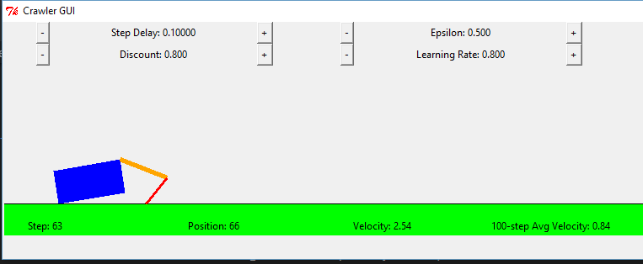
Q-Learning Example: Crawler Robot
Credit: CS188 – Intro to AI, UC Berkeley, ai.berkely.edu

Slide 24
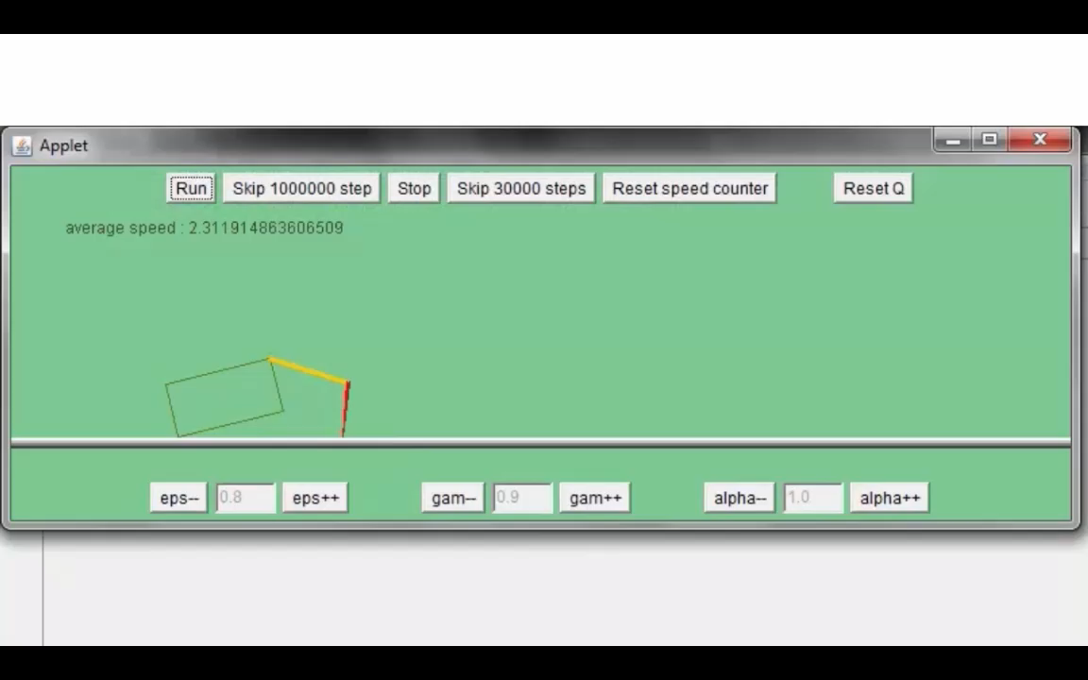
Video 1 of Q-Learning demo -- Crawler
Credit: CS188 – Intro to AI, UC Berkeley, ai.berkely.edu

Slide 25
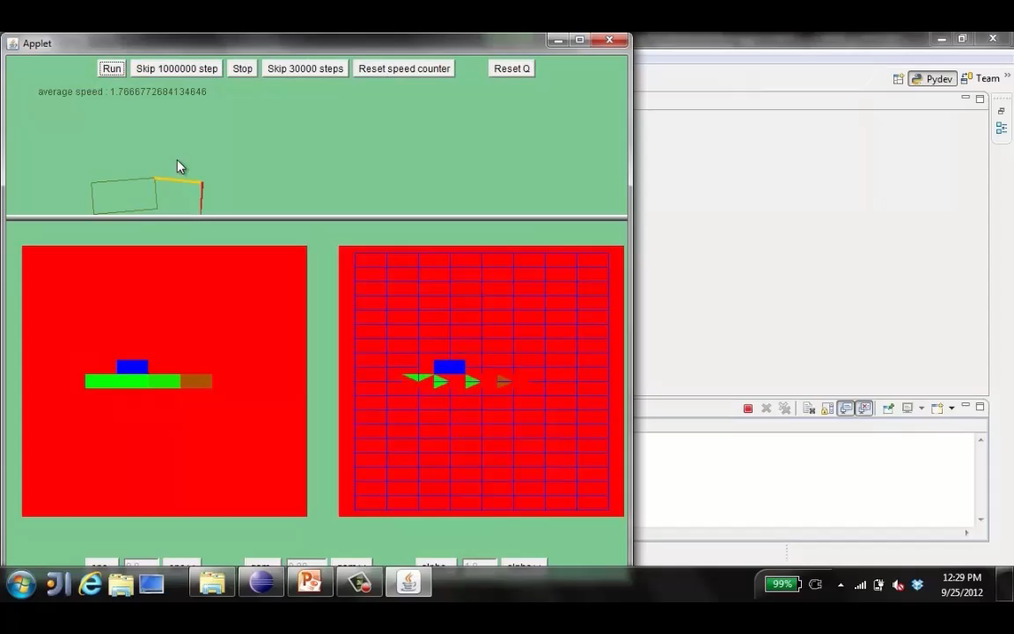
Video 2 of Q-Learning demo -- Crawler
Credit: CS188 – Intro to AI, UC Berkeley, ai.berkely.edu

Slide 26
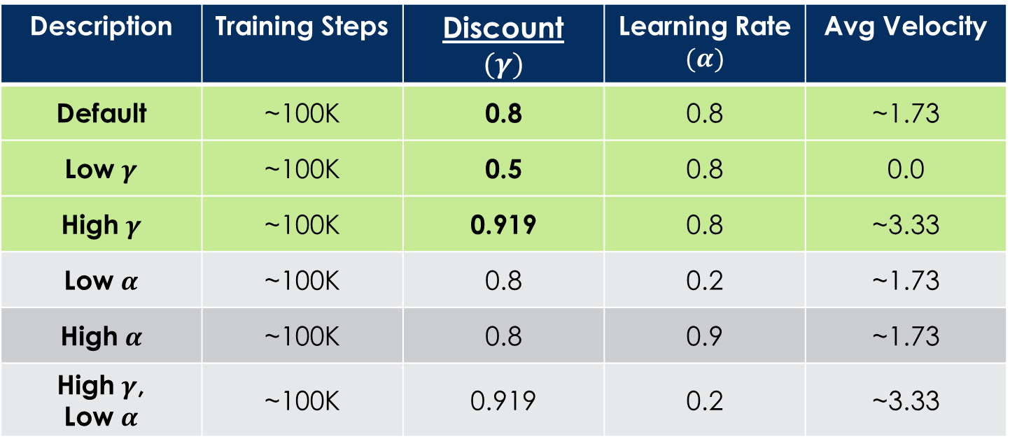
Q-Learning Example: discount effect
Update rule:
Description | Training Steps | Discount $$(γ)$$ | Learning Rate $$(α)$$ | Avg Velocity
Default | ~100K | 0.8 | 0.8 | ~1.73
Low $γ$ | ~100K | 0.5 | 0.8 | 0.0
High $γ$ | ~100K | 0.919 | 0.8 | ~3.33
Low $α$ | ~100K | 0.8 | 0.2 | ~1.73
High $α$ | ~100K | 0.8 | 0.9 | ~1.73
High $γ$, Low $α$ | ~100K | 0.919 | 0.2 | ~3.33

Slide 27
Introducing Reinforcement learning
Scott O’Hara
Metrowest Developers Machine Learning Group
01/29/2020

Slide 28
Detailed References
“Demystifying Deep Reinforcement Learning,” 2015, Tambet Matiisen
https://www.intel.ai/demystifying-deep-reinforcement-learning/
University of California, Berkeley CS188:
CS188 – Introduction to Artificial Intelligence, Profs. Dan Klein, Pieter Abbeel, et al. http://ai.berkeley.edu/home.html
David Silver, DeepMind:
Introduction to Reinforcement Learning http://www0.cs.ucl.ac.uk/staff/d.silver/web/Teaching.html
CS181 course at Harvard University:
CS181 Intelligent Machines: Perception, Learning and Uncertainty, Sarah Finney, Spring 2009
CS181 Intelligent Machines: Perception, Learning and Uncertainty, Prof. David C Brooks, Spring 2011
CS181 – Machine Learning, Prof. Ryan P. Adams, Spring 2014. https://github.com/wihl/cs181-spring2014
CS181 – Machine Learning, Prof. David Parkes, Spring 2017.https://harvard-ml-courses.github.io/cs181-web-2017/

Slide 29
UC Berkeley CS188 is a great resource
http://ai.berkeley.edu/home.html
Covers:
Search
Constraint Satisfaction
Games
Reinforcement Learning
Bayesian Networks
Surveys Advanced Topics
And more…
Contains: accessible, high quality YouTube videos, PowerPoint slides and homework.
Series of projects based on the video game PacMan.
Material is used in many courses around the country.

Slide 30
Extra Slides

Slide 31
MDP-based Algorithms
There are many algorithms based on the Markov Decision Process
These algorithms can be divided into several subclasses. One way to classify these algorithms is based on how much is known about the environment.
MDP algorithms
MDP-based algorithms assuming perfect knowledge of the states, actions, rewards and transitions of the problem space.
Reinforcement learning algorithms:
MDP-based algorithms with knowledge of the states and actions but no knowledge of the rewards and transitions of the problem space.

Slide 32
3 mdp algorithms
Assumes complete knowledge of the MDP.
Expectimax – a top-down recursive tree search algorithm similar to the minimax game search algorithm with a fixed search depth (finite horizon) that finds the optimal expected value of the current state.
Value Iteration – a bottom-up dynamic programming algorithm that finds the optimal expected value of every state. There are two variants: 1) finite horizon value iteration; and 2) infinite horizon value iteration.
Policy Iteration - a bottom-up dynamic programming algorithm that finds the optimal policy.

Slide 33
Reinforcement learning algorithms
Assumes incomplete knowledge of the MDP i.e., no knowledge of the reward or transition models.
Model-based reinforcement learning are based on the various MDP algorithms and try to build the reward and transition models by exploring the environment.
Model-free reinforcement learning ignore the reward and transition models and try to learn the Q and/or V functions directly.

Slide 34
Model-based Reinforcement learning
Model-based reinforcement learning is based on the typically involve alternating between the following steps:
Exploit the environment using the current reward and transition models.
Explore the environment to learn the reward and transition models.
Run an MDP algorithm to create new reward and transition models.

Slide 35
Model-free Reinforcement learning
Model-free reinforcement learning does not try to learn the reward and transition models. Instead it attempts to find an optimal policy π using other means. There are many such algorithms including:
Q-Learning
SARSA
Monti-Carlo
Approximate Q-Learning
Dyna-Q
Deep Q-Learning (DQN)
…

Slide 36
Model-based vs model-free
Model-Based
Pros:
Makes maximal use of experience.
Solves model optimally given enough experience.
Cons:
Requires computationally expensive solution procedure.
Requires the model to be small enough to solve.
Model-Free
Pros:
Solution procedure is relatively more efficient.
Can handle much larger models.
Cons:
Learns more slowly. Does not learn as much as a model-based RL in a single training episode. (“Leaves information on the table”).
Unable to make predictions about transitions in the environment.

